Slide 1
CoECS: Preparing for Advisement And Registration
The Advising & Enrichment Center – NYC
26 W. 61st St. 2nd Floor

Slide 2
Preparing for Fall 2020
Review Spring 2020 Classes
  How are classes going? What grades have you received?
  Do you need the support of any academic resources to be successful for the rest of the semester?
**Have you submitted all AP scores or college credits from high school? Has NYIT confirmed they have been received?
Academic Resources:
Learning Center, 26 W. 61st St., Rooms 205 & 206
Math Resource Center, 16 W. 61st St., room 717
Science Learning Center, 1855 Broadway, Room 306
Writing Center, 16 W. 61st St., Room 609

Slide 3
CoECS Academic Requirements
Students enrolled in the Mechanical Engineering, Electrical and Computer Engineering, or Computer Science programs must earn a grade of C- or higher in all required Math, Physics, Computer Science, and Engineering Courses.
  Grades of D+ or below cannot be counted towards a student’s degree.
Undeclared students who intend to pursue Mechanical Engineering, Electrical and Computer Engineering, or Computer Science must meet the conditions above in order to qualify for entrance into the program.

Slide 4

Semester Map
What is a Semester Map?
A semester map is an example of the semester-by-semester sequence of courses a student has to complete in order to satisfy all major and core requirements.
Where can you find your Semester Map?

Slide 5
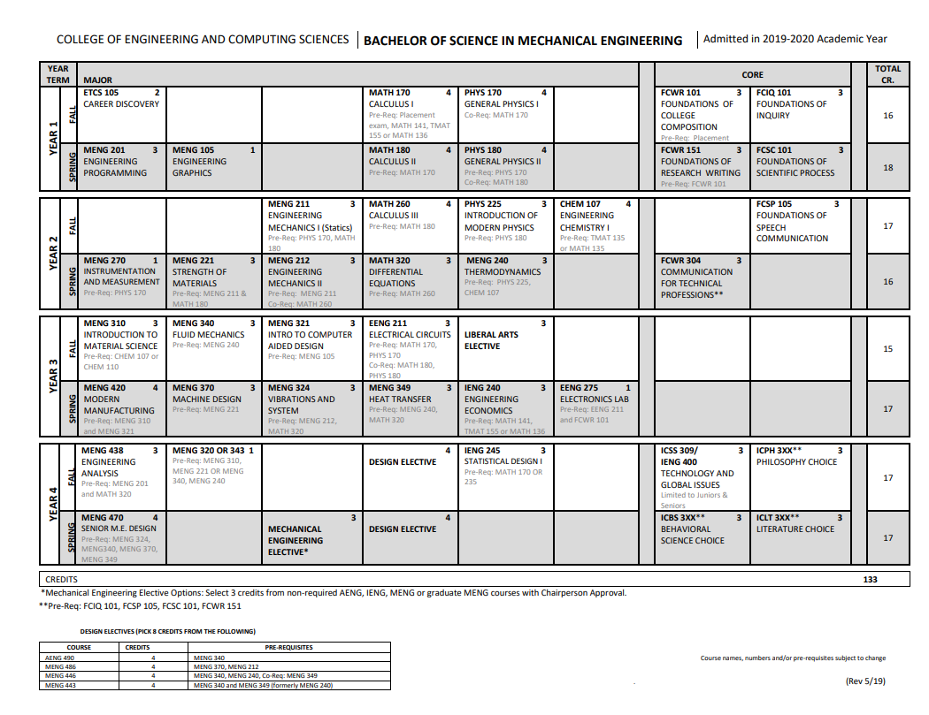
Semester Map – Cont.’d
Track Your Courses
Course Credit
Dotted Line = Courses in Progress
Solid Line = Courses Completed
Pre-requisite(s) or Co-requisite(s)
Progression of Courses
Notes:
speak about PHYS dept offering PHYS 170 during winter session

Slide 6
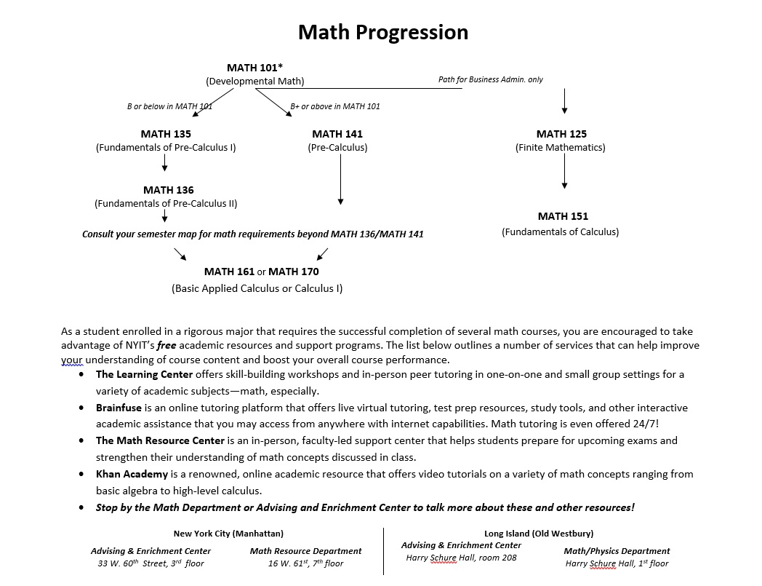
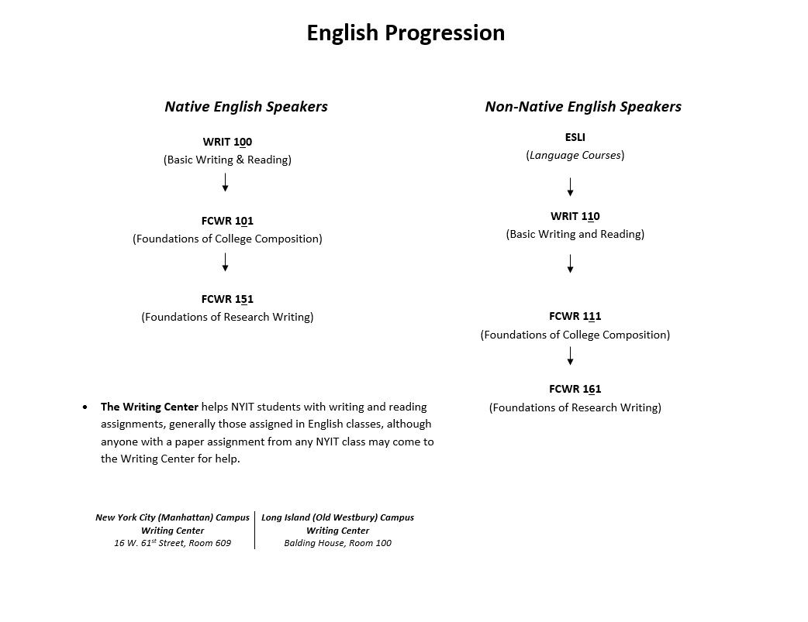
Math and English Progression Chart

Slide 7
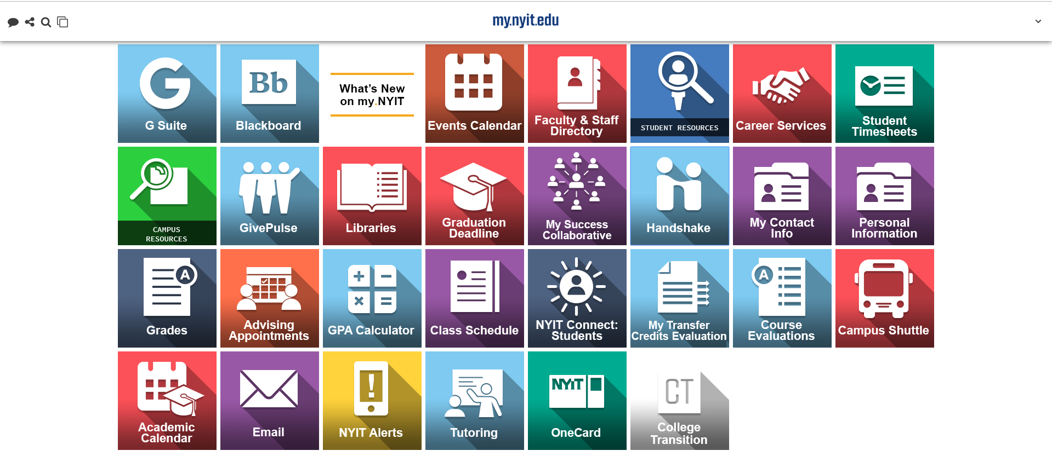
my.NYIT

Slide 8
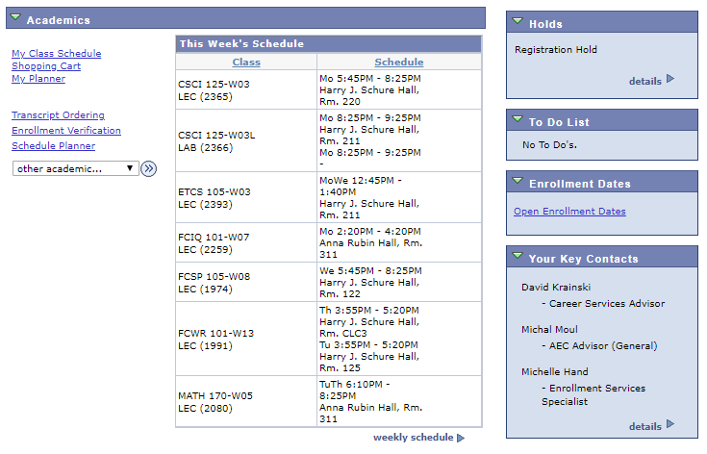
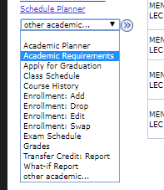
NYIT Connect: Student Center
Important items to check when getting ready for Registration
To view your STAR

Slide 9
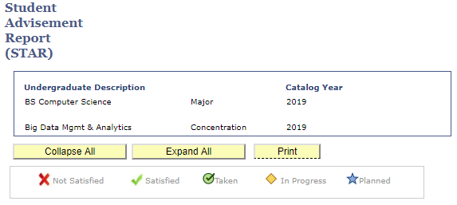
STudent Advisement Report
Tells you which Semester Map to follow.
Note these symbols when reviewing your STAR
All TC’s or PC’s will have this symbol.
All Fall 2019 Courses will have this symbol.

Slide 10
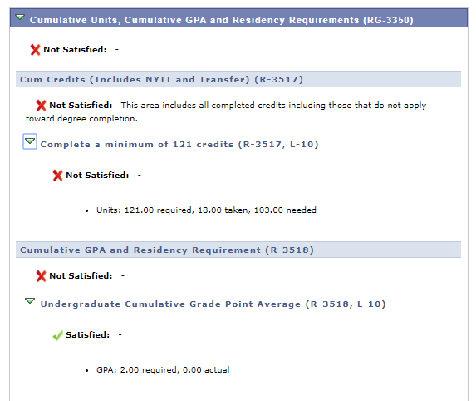
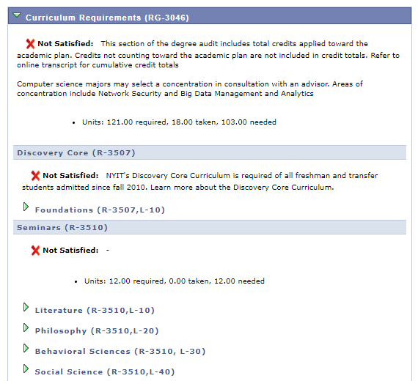
STudent Advisement Report - cont.’d
Total Credits required for your degree, number of credits you've taken and are in progress, how many credits you have left to complete your degree
Core Requirements
Your Current cGPA vs. required University cGPA

Slide 11
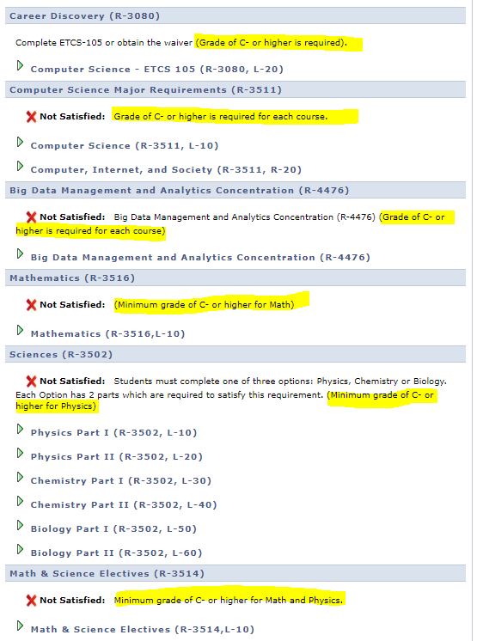
STudent Advisement Report - cont.’d
Specific Grade Requirements for major related courses as well as math and science

Slide 12
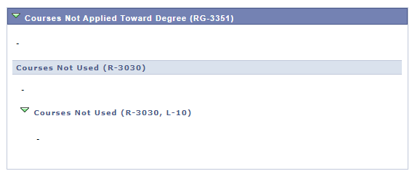
STudent Advisement Report - cont.’d
Courses that do not apply towards your degree such as “W or F” grades, course(s) from a different major, grades that fall below major requirements or some pre-requisite courses

Slide 13
How To Register

Slide 14

Schedule Planner
NYIT Connect: Students > Student Center > Schedule Planner

Slide 15
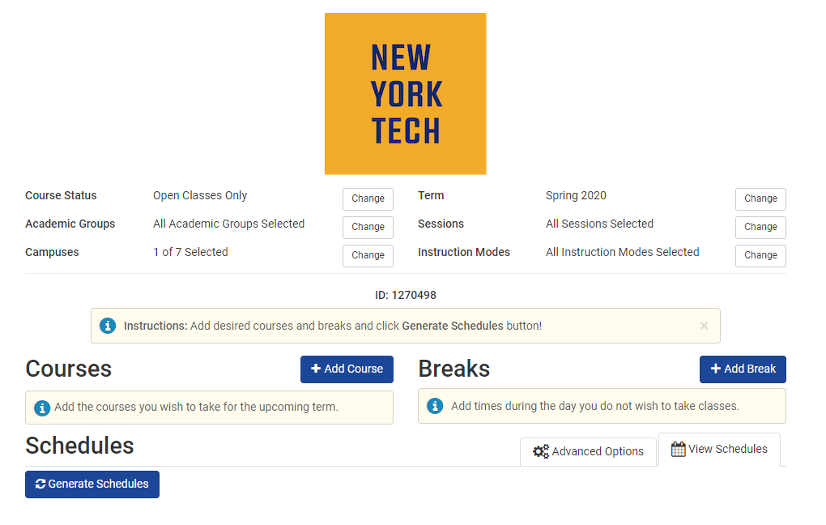
Schedule Planner – Cont.’d
Select Term: Fall 2020
Select Campus:New York City Campus

Slide 16
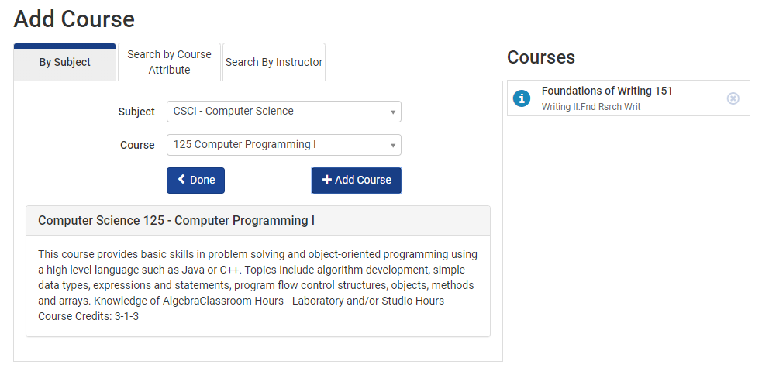
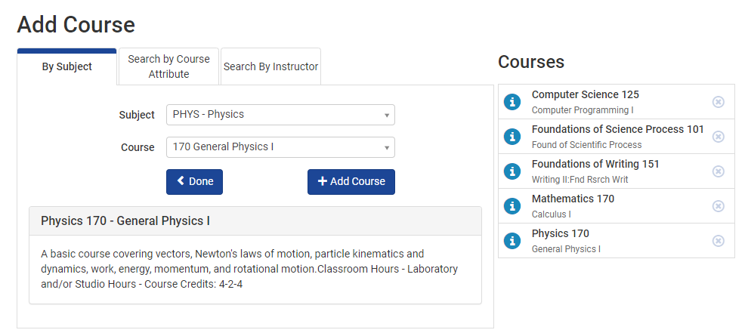
Add Courses
Build your list of courses here

Slide 17
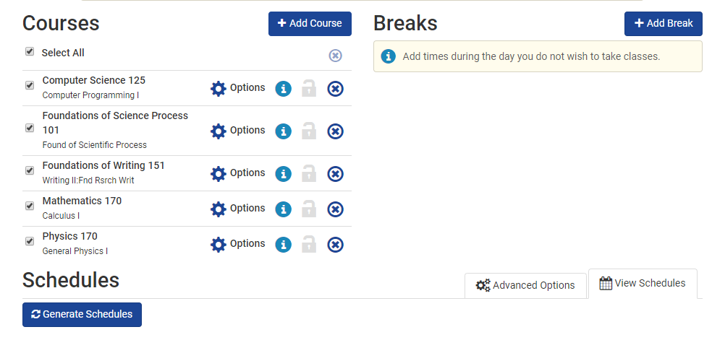
Generate Schedules
Add a Break:
Do you have a work schedule to accommodate? A commute?
To look at schedules, click “view” next to the options
You can favorite schedules as well.
Once you’ve added all of your classes (and a break), click “Generate Schedules”

Slide 18
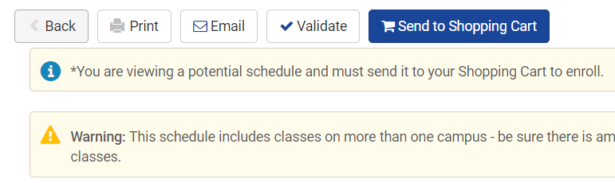
Select Schedule
Click “Validate” to make sure there are no conflicts
Click “Send to Shopping Cart” to add this schedule of classes to your Enrollment Shopping Cart” in your Student Center

Slide 19
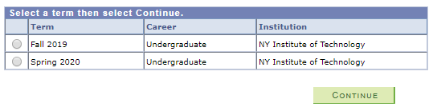
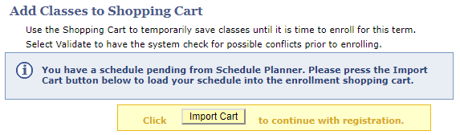
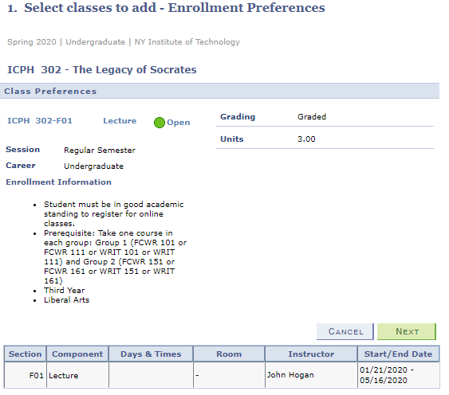
Enrollment Shopping Cart
Head back to your Student Center > “Enrollment Shopping Cart” (under your current list of classes)
Then select Fall 2020 as the term.
“Import Cart” > “Next”
through all of the classes you
chose.

Slide 20
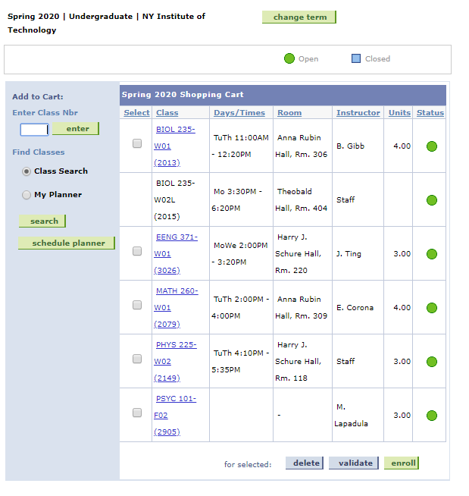
Enrolling in Classes
These classes will stay in your cart until your Enrollment Date. On that day, you can check off each class and click “Enroll”

Slide 21
Questions?
Contact AEC aec@nyit.edu

